Slide 1

Blood vessel dysfunctional
Using intelligence methods

Slide 2
PROBLEM STATEMENT
Diagnosing dysfunctional of the blood vessel disease is a challenging task and it is difficult to identify due to several risk factor.
Since we have large amount of data which can be used to predict and make the detection happen at early stage

Slide 3
ATTRIBUTE INFORMATION
age : age in years
sex : (1 = male; 0 = female)
cp : chest pain type
trestbps : resting blood pressure (in mm Hg on admission to the hospital)
chol : serum cholestoral in mg/dl
fbs : (fasting blood sugar > 120 mg/dl) (1 = true; 0 = false)
restecg : resting electrocardiographic results
thalach : maximum heart rate achieved
exang : exercise induced angina (1 = yes; 0 = no)
oldpeak : ST depression induced by exercise relative to rest
slope : the slope of the peak exercise ST segment
ca : number of major vessels (0–3) colored by flourosopy
thal : 1 = normal; 2 = fixed defect; 3 = reversable defect
target : 1 = disease; 0 = no disease

Slide 4
CLASSIFIER
Logistic Regression
Decision Tree Classifier
K Nearest Neighbors
Support Vector Machine
Gaussian Naive Bayes
Random Forest Classifier
Artificial Neural Network

Slide 5
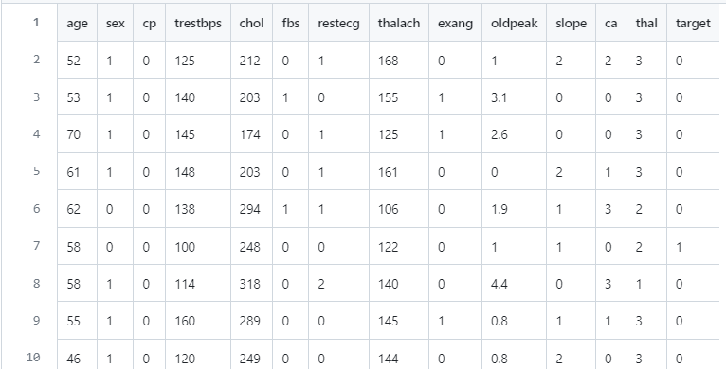
DATASET

Slide 6
SplitTING AND TRAINING
Train set: The training dataset is a set of data that was utilized to fit the model. The dataset on which the model is trained. This data is seen and learned by the model.
Test set: The test dataset is a subset of the training dataset that is utilized to give an accurate evaluation of a final model fit.
validation set: A validation dataset is a sample of data from your model’s training set that is used to estimate model performance while tuning the model’s hyperparameters.

Slide 7
# using the train test split function
X_train, X_test,
y_train, y_test = train_test_split(X,y ,
random_state=104,
test_size=0.25,
shuffle=True)
# printing out train and test sets
print('X_train : ')
print(X_train.head())
print('')
print('X_test : ')
print(X_test.head())
print('')
print('y_train : ')
print(y_train.head())
print('')
print('y_test : ')
print(y_test.head())

Slide 8
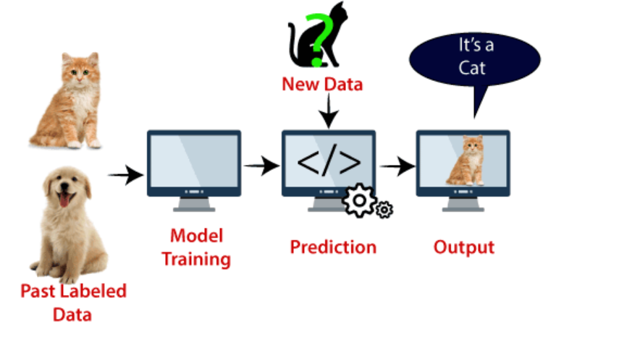
Support vector machine
SVM can be understood with the example that we have used in the KNN classifier. Suppose we see a strange cat that also has some features of dogs, so if we want a model that can accurately identify whether it is a cat or dog, so such a model can be created by using the SVM algorithm. We will first train our model with lots of images of cats and dogs so that it can learn about different features of cats and dogs, and then we test it with this strange creature. So as support vector creates a decision boundary between these two data (cat and dog) and choose extreme cases (support vectors), it will see the extreme case of cat and dog. On the basis of the support vectors, it will classify it as a cat.

Slide 9
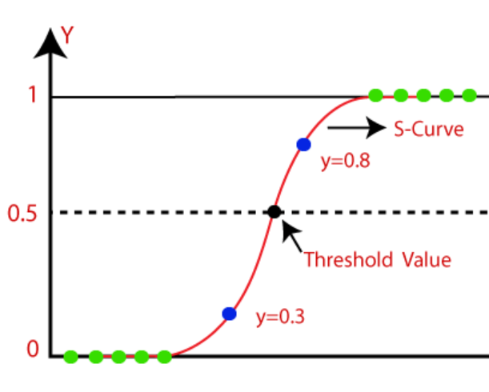
Logistic regression
Logistic Regression can be used to classify the observations using different types of data and can easily determine the most effective variables used for the classification. The below image is showing the logistic function:

Slide 10
Naïve Bayes
Naïve Bayes algorithm is a supervised learning algorithm, which is based on Bayes theorem and used for solving classification problems.
It is mainly used in text classification that includes a high-dimensional training dataset.
Naïve Bayes Classifier is one of the simple and most effective Classification algorithms which helps in building the fast machine learning models that can make quick predictions.

Slide 11
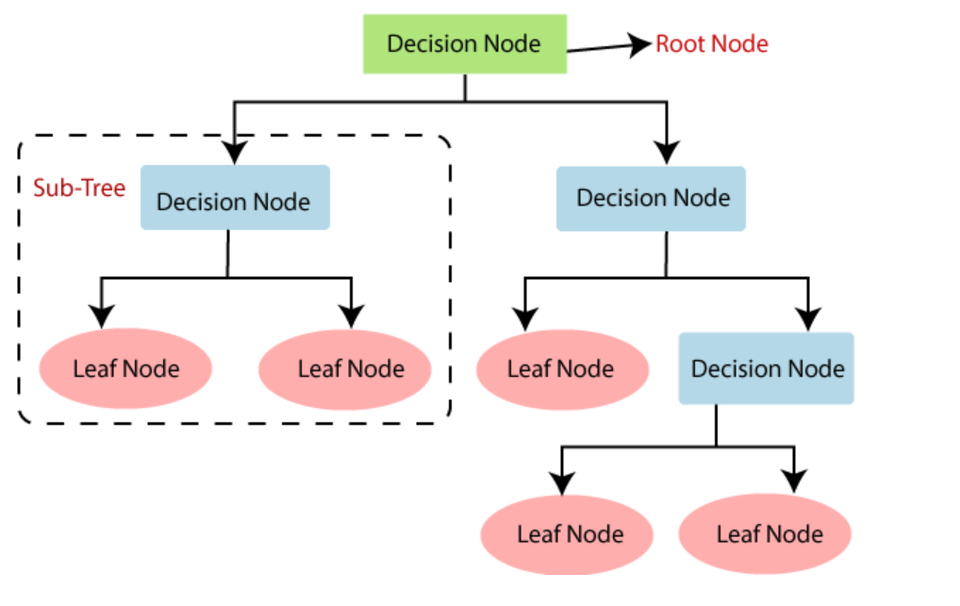
Decision TREE
Decision Tree is a Supervised learning technique that can be used for both classification and Regression problems, but mostly it is preferred for solving Classification problems. It is a tree-structured classifier, where internal nodes represent the features of a dataset, branches represent the decision rules and each leaf node represents the outcome.

Slide 12
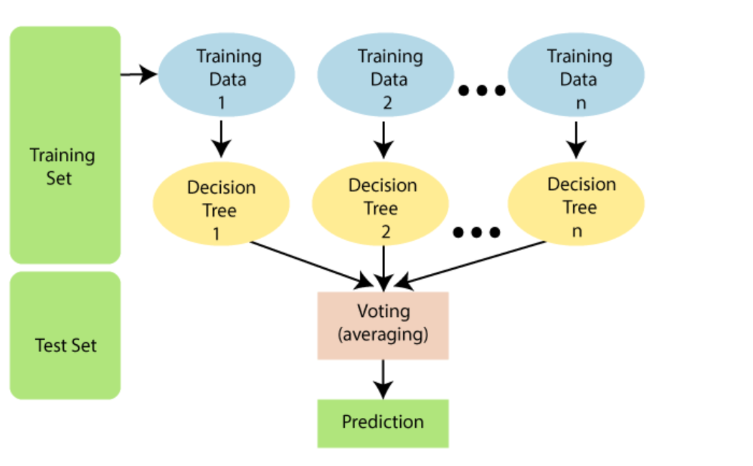
RANDOM FOREST
Random Forest is a classifier that contains a number of decision trees on various subsets of the given dataset and takes the average to improve the predictive accuracy of that dataset." Instead of relying on one decision tree, the random forest takes the prediction from each tree and based on the majority votes of predictions, and it predicts the final output.

Slide 13
CONFUSION MATRIX
A confusion matrix is a matrix that summarizes the performance of a machine learning model on a set of test data. It is often used to measure the performance of classification models, which aim to predict a categorical label for each input instance. The matrix displays the number of true positives (TP), true negatives (TN), false positives (FP), and false negatives (FN) produced by the model on the test data.

Slide 14
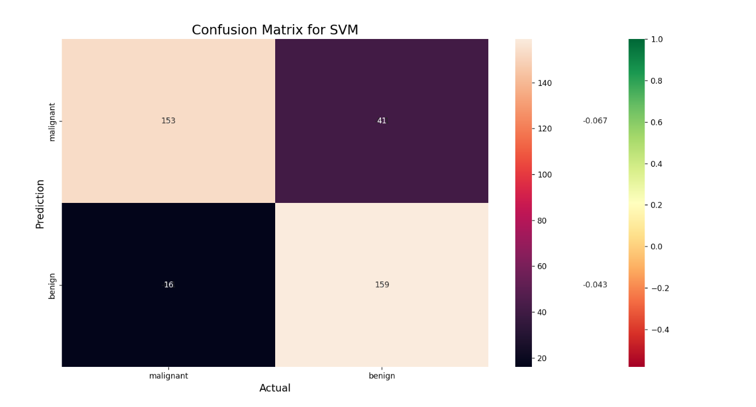
Steps:
Import the necessary libraries like Numpy, confusion_matrix from sklearn.metrics, seaborn, and matplotlib.
Create the NumPy array for actual and predicted labels.
compute the confusion matrix.
Plot the confusion matrix with the help of the seaborn heatmap.

Slide 15
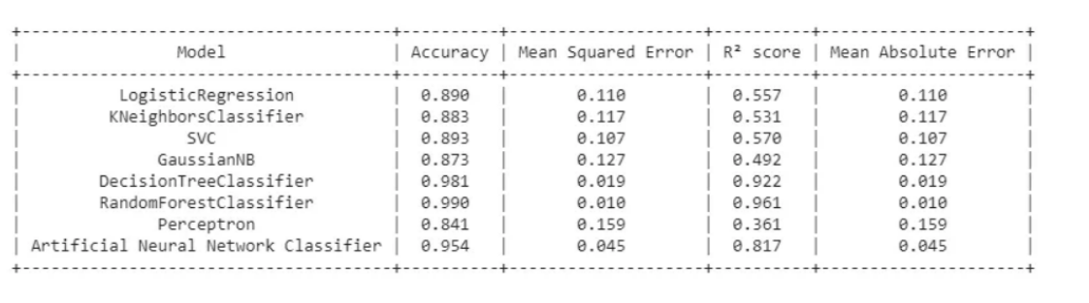
VisualizATION

